Slide 1
Policy Schedule
Main Objectives
To provide a customer-specific overview of the coverage
To specify optional coverage extensions
To specify key limits (and sub-limits) for coverages
To define any endorsements to the contract wording
Form
Document templates with embedded data
Data sent from Policy Admin System using XML or JSON
Schedules are sent to the customer in PDF format
Policy Wording
Main Objectives
To provide details of the coverage (standard and optional)
To specify defined terms
To define conditions for coverage
To define exclusions to coverage
Form
Fixed documents in PDF form
Contract wordings are often an expression of the ‘product’
Wordings are sent to the customer in PDF format

Slide 2
Contract Innovation Landscape
Automation around the Contract
Essentially, the contract remains unchanged and any automation is peripheral to the contract object
Smart contracts – separate representation of contract often focussing on contract performance
NLP and Gen AI – seeing increasing use for basic queries
1
Contract Automation Systems
Smart Contracts
NLP and Gen AI
Computable
Contracts
Markup Languages
CNLs (some DSLs)
Basic Modularisation of the Contract
Here, the focus is on breaking the contract down into smaller objects with some metadata.
There is limited application of sematic enrichment beyond metadata application.
Document Assembly – ‘Configuration intelligence’ is hardwired into the system
Extent of
Contract Computability
2
1
3
Document Assembly
Systems
Clause Libraries
Unstructured
Natural Language Contracts
2
Establishing Computable Contracts
Computable contracts have much of the ‘intelligence’ built into the objects
High levels of systems interoperability
Markup – Application of structured authoring and graph-based approaches (with semantic enrichment)
Controlled Natural Languages and Domain-specific Languages e.g. InsurLE for exposing contract logic
3
Extent of Modularisation

Slide 3
Coverage against all possible risks
I = Coverage risks in insuring clause
C = Coverage Extensions
E = General Exclusion
C_{E} = Writeback for Exclusion E
G = Violation of General Condition
C
E
G
I
C_{E}

Slide 4
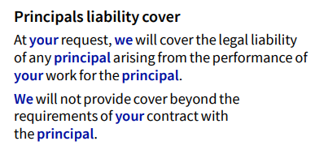
Contract Object
(Policy Wording)
The overall policy/contract wording
The ‘Insurance Product’
Component Group
Represents overall
object/document structure
Structure
Basic ‘building block’ of contract
Content
Component
Element
Finer level of granularity to allow
for more accurate search and retrieval

Slide 5
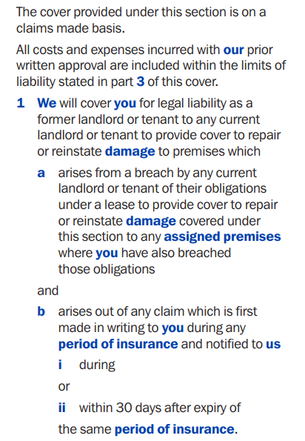
Cross-referencing to other parts of the contract object
Most insurance policy wordings use bold lettering to indicate a defined term (and also cross-referencing a definition component)
Nesting within components can often exceed three levels, and in some cases reach five or six levels

